Slide 1
Notes:
Main title slide.

Slide 2
XXX
NAI and KSM A New & Stronger Company Combined Resources for Custom Interconnect Solutions
XXXX XXXXX XXXX XXXX
Notes:
For secondary title, if needed (optional).

Slide 3
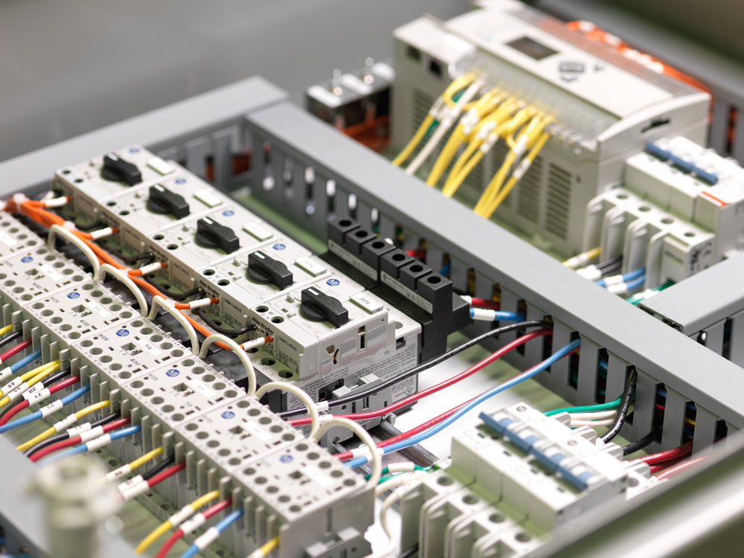
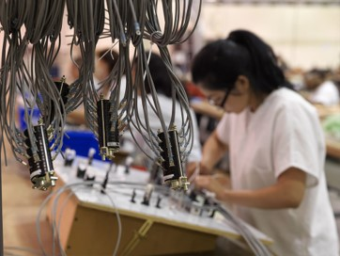
NAI & KSM…A New & Stronger Company
Why this Acquisition?
Benefits for KSM Electronics:
Added engineering capability
Additional production capacity
Provides a presence in Asia
Strong financial backing with access to capital
Access to additional customers
Leverages a combined supply chain
Adds fiber optic technology to product portfolio
Renews capability with electro-mechanical builds
Reliable Connectivity Solutions
Notes:
Main text slide with subhead; with optional image. Note a title in the header can be set up for the presentation topic, or sub-topics. Please use font sizes shown.

Slide 4
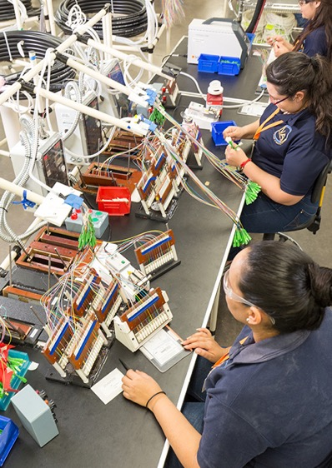
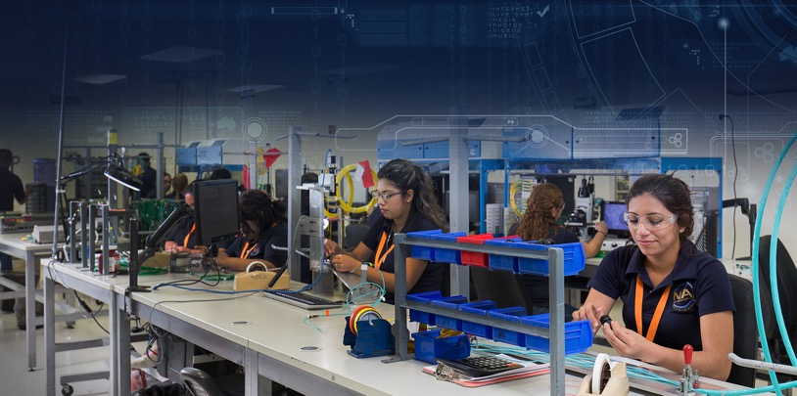
NAI & KSM…A New & Stronger Company
Why this Acquisition?
Benefits for NAI:
Expansion of Industrial business – hi flex cable, servo motors, etc.
Add market expertise in Military, Aerospace/Avionics, Marine, Security, and Transportation
Wholesale pricing from KSM distribution business for cable and components
Common quality commitment & continuous improvement culture
Access to additional customers
Adds Vendor Managed Inventory (VMI) capabilities for NAI customers
Broadens experience base in market segments
Reliable Connectivity Solutions
Notes:
Main text slide with subhead; with optional image. Note a title in the header can be set up for the presentation topic, or sub-topics. Please use font sizes shown.

Slide 5
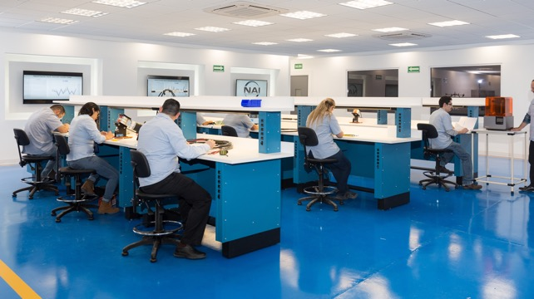
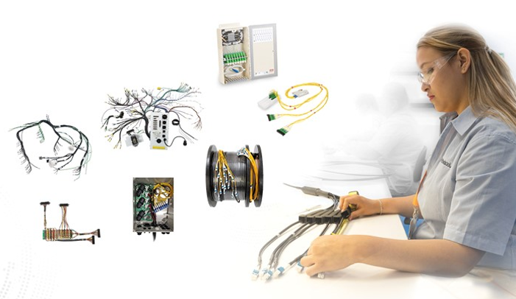
NAI & KSM…A New & Stronger Company
NAI Connectivity Solutions – Overview
Agile designer and manufacturer of custom cable,
harness and electro-mechanical assemblies
• Custom Engineering & Manufacturing
• Flexible, Nimble and Quick
• Centers of Excellence (CoEs) for New
Product Development
• Global Sourcing
• Products for Critical Applications
• Relentless Quality Management Systems
• An Organization Focused on Learning
• Strong Financial Backing
• Injection Molding & Cleanroom Manufacturing
Reliable Connectivity Solutions
Notes:
Main text slide with subhead; with optional image. Note a title in the header can be set up for the presentation topic, or sub-topics. Please use font sizes shown.

Slide 6
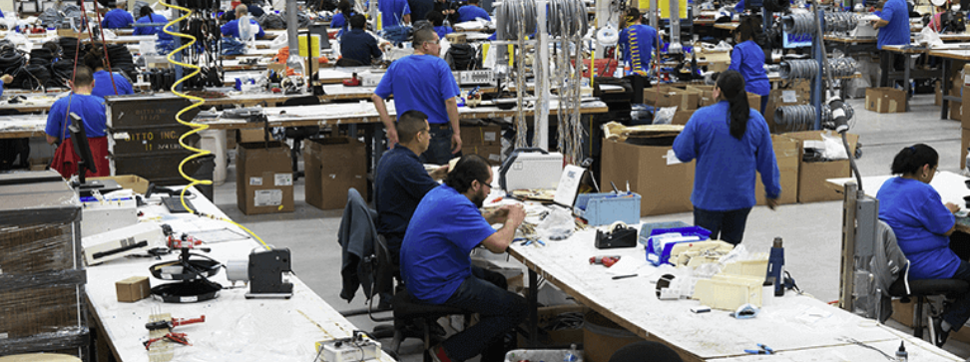
NAI & KSM…A New & Stronger Company
KSM Connectivity Solutions - Overview
Also an agile designer and manufacturer of custom cable, harness and electro-mechanical assemblies. KSM is also a renowned distributor of cable and electronic components.
Custom Engineering and Manufacturing
Value-added Services, such as Laser and Inkjet Printing, Autosplice Machining, Ultrasonic Welding, etc.
Hi-flex Robotic and Servo Motor Cables
Locations in Florida, Illinois and Mexico
Vendor Managed Inventory (VMI)
Flexible, Nimble and Quick
Strong Financial Backing
Reliable Connectivity Solutions
Notes:
Main text slide with subhead; with optional image. Note a title in the header can be set up for the presentation topic, or sub-topics. Please use font sizes shown.

Slide 7
NAI & KSM…A New & Stronger Company
Portrait of NAI
• 5 plants with nearly 500,000 sq. ft. production capacity
• Over 2.5 million assemblies/month
• Over 25 million terminations/month
• Over 2,000 personnel and growing
• 120 degreed engineers
• Flexible and nimble; ramp up quickly for new projects
• Global procurement network
• Global operations for value & proximity
• Dedicated cells for Hi Mix / Low Volume & Hi Volume / Low Mix
• Injection Molding Capability
• Serves Industrial, Medical and Telecom industries
Reliable Connectivity Solutions
Notes:
Main text slide with subhead; with optional image. Note a title in the header can be set up for the presentation topic, or sub-topics. Please use font sizes shown.

Slide 8
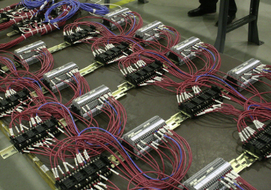
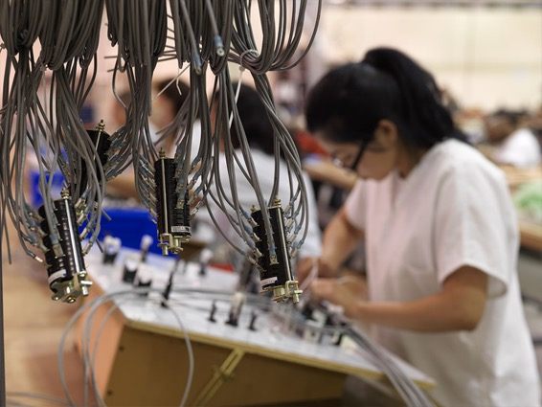
NAI & KSM…A New & Stronger Company
Portrait of KSM
• 2 plants with nearly 100,000 sq. ft. production capacity in Mexico and the U.S.
• Over 350 personnel capable of supporting various
custom requirements of customers
• Low Volume / High Mix custom wire harness
capabilities
• Flexible and nimble; ramp up quickly for new projects
• Provider of wire and cable distribution services
• Serves similar industries as NAI, plus Military, Marine
Aerospace/Avionics, Security, Transportation, and Energy
Reliable Connectivity Solutions
Notes:
Main text slide with subhead; with optional image. Note a title in the header can be set up for the presentation topic, or sub-topics. Please use font sizes shown.

Slide 9
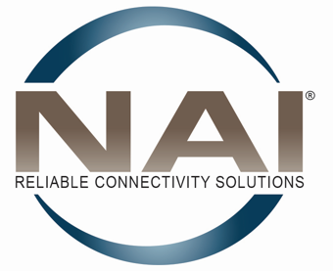
NAI & KSM…A New & Stronger Company
Combined Capabilities
A New & Stronger Company
&
Reliable Connectivity Solutions
Notes:
Main text slide with subhead; with optional image. Note a title in the header can be set up for the presentation topic, or sub-topics. Please use font sizes shown.

Slide 10
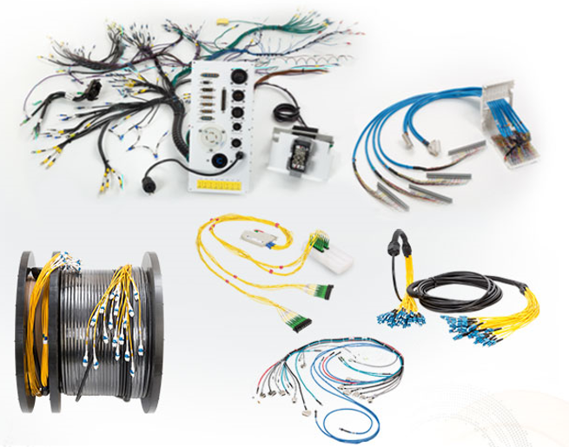
NAI & KSM…A New & Stronger Company
Combined Custom Engineering & Manufacturing
• Cable Assemblies
• Harness Assemblies
• Pre-terminated Assemblies
• Hybrid Assemblies
• Electro-Mechanical Assemblies
• Small to Complex
• Low Mix / High Volume
• High Mix / Low Volume
Reliable Connectivity Solutions
Notes:
Main text slide with subhead; with optional image. Note a title in the header can be set up for the presentation topic, or sub-topics. Please use font sizes shown.

Slide 11
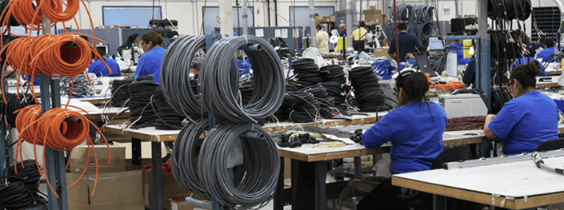
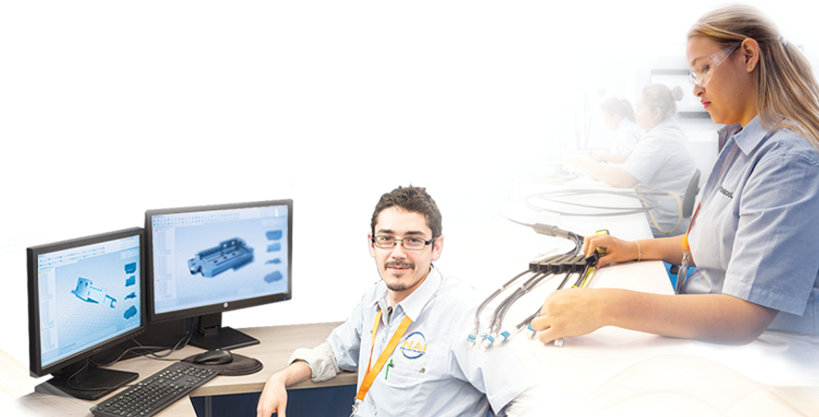
NAI & KSM…A New & Stronger Company
Combined Custom Engineering & Manufacturing
Save by Outsourcing!
• Added value with design engineering services,
including CAD, 3D printing, testing, reverse engineering
• Engineering engagement options
• Cost savings with alternate and wholesale components
• Diligent QMS for product reliability
• Quick turnaround on samples and new products
• Fast prototyping
• Design for Manufacturability (DFM)
• Product development facilities
Reliable Connectivity Solutions
Notes:
Main text slide with subhead; with optional image. Note a title in the header can be set up for the presentation topic, or sub-topics. Please use font sizes shown.

Slide 12
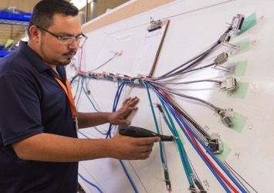
NAI & KSM…A New & Stronger Company
Combined New Product Development
NAI’s New Product Introduction (NPI) Process
for new projects with an existing design
• Prepares new projects for production
• Prepare tools & visual aids needed to guide assembly
• Utilize Advanced Product Quality Planning (APQP) process, similar to auto industry
• Create prototype, production sample & BOM
• Dedicated team of engineers & quality experts
• Dedicated facility space
Reliable Connectivity Solutions
Notes:
Main text slide with subhead; with optional image. Note a title in the header can be set up for the presentation topic, or sub-topics. Please use font sizes shown.

Slide 13
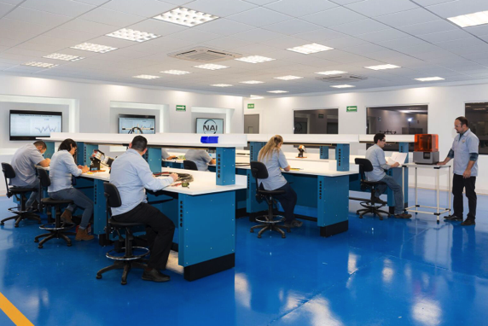
NAI & KSM…A New & Stronger Company
Combined New Product Development
Centers of Excellence (CoEs) for new projects
requiring design and testing
• CoEs design and develop fiber optic and copper
cable assemblies for customers who need to outsource their design capabilities
• Achieve cost savings for customers by using alternative processes and components to reduce the purchase price variance
• Support the NAI manufacturing process by employing DFM principles in the design process
Reliable Connectivity Solutions
Notes:
Main text slide with subhead; with optional image. Note a title in the header can be set up for the presentation topic, or sub-topics. Please use font sizes shown.

Slide 14
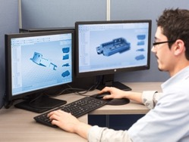
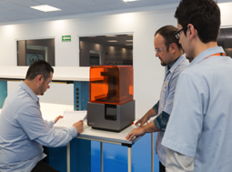
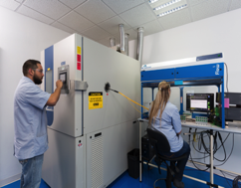
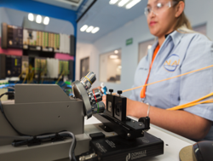
NAI & KSM…A New & Stronger Company
Centers of Excellence (CoEs)
CAD Design & 3D Printing
Testing
Thermal, Immersion, Cross-section, End Face & Geometry, Tensile, Pressure, Texture, IL/IR, Electrical Tests
Reliable Connectivity Solutions
Notes:
Main text slide with subhead; with optional image. Note a title in the header can be set up for the presentation topic, or sub-topics. Please use font sizes shown.

Slide 15
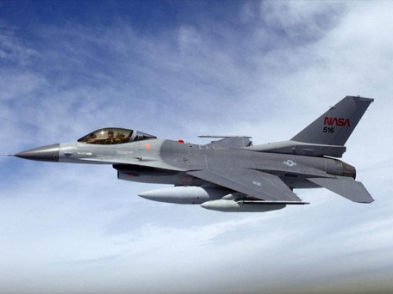
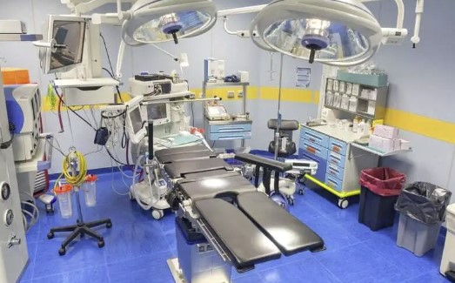
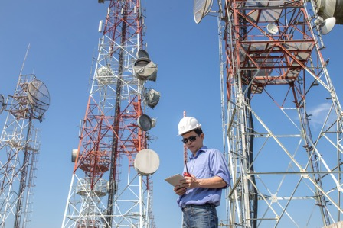
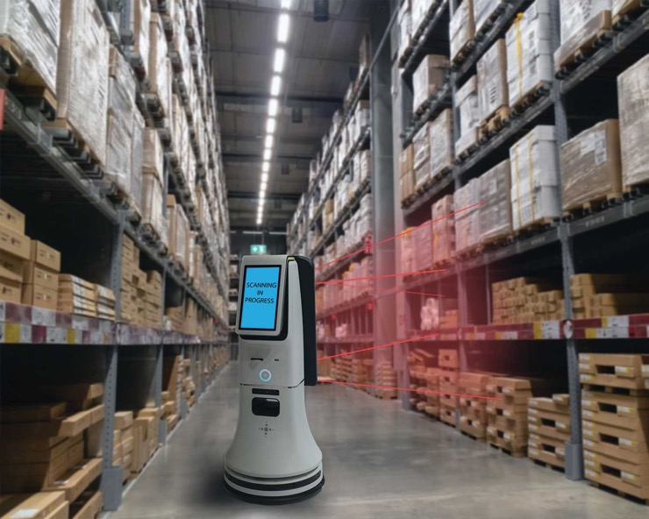
NAI & KSM…A New & Stronger Company
Technologies for Critical Applications
Industrial Technologies
Medical Devices
Medical Equipment
Telecom
Communications
Data
Aerospace / Avionics
Energy
Government / Military
Marine
Reliable Connectivity Solutions
Notes:
Main text slide with subhead; with optional image. Note a title in the header can be set up for the presentation topic, or sub-topics. Please use font sizes shown.

Slide 16
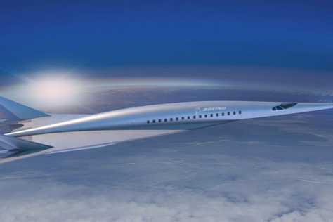
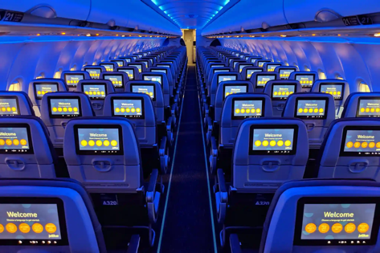
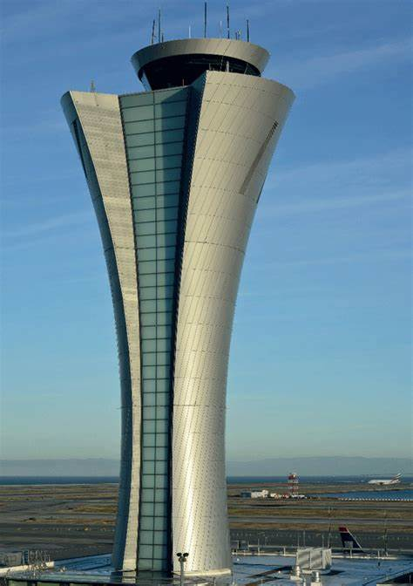
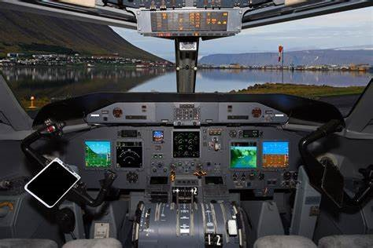
NAI & KSM…A New & Stronger Company
Technologies for Aerospace Applications
Commercial & Military Aerospace & Avionics
Harnesses for commercial & super 1st class integrated cabin experience
Multiple applications from actuator motors for seating, entertainment and communications
Wire harnesses for anti-collision system, antenna cables & radar systems
Ground communication systems to assist pilot navigation
ITAR Registered
Reliable Connectivity Solutions
Notes:
Main text slide with subhead; with optional image. Note a title in the header can be set up for the presentation topic, or sub-topics. Please use font sizes shown.

Slide 17
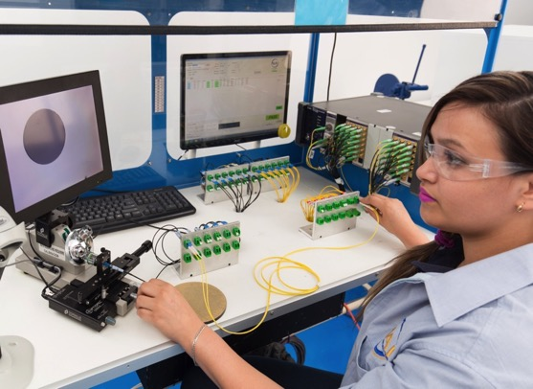
NAI & KSM…A New & Stronger Company
Stringent Quality Management Systems
Fiber Optics: Inline Quality Control
All assemblies are 100% inspected. State-of-the-art
equipment used for:
• Insertion Loss / Return Loss
• Attenuation
• Geometry, including concentricity and light continuity
• End face inspection after polishing
• Air cleaning equipment removes contaminants
Reliable Connectivity Solutions
Notes:
Main text slide with subhead; with optional image. Note a title in the header can be set up for the presentation topic, or sub-topics. Please use font sizes shown.

Slide 18
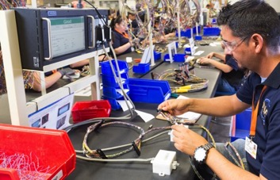
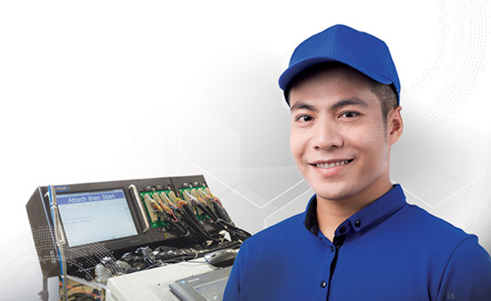
NAI & KSM…A New & Stronger Company
Stringent Quality Management Systems
Copper: Inline Quality Control
All assemblies are 100% inspected. Electrical test include continuity, high voltage (HiPot) and capacity. Some of the tests we perform include:
• Subassy electrical test
• Manufacturing visual inspection
• QA inspection
• Plug blade height
• Tensile test
• Pressure test
• Texture test
• Insertion Loss / Return Loss
Reliable Connectivity Solutions
Notes:
Main text slide with subhead; with optional image. Note a title in the header can be set up for the presentation topic, or sub-topics. Please use font sizes shown.

Slide 19
NAI & KSM…A New & Stronger Company
Stringent Quality Management Systems
Sampling of Many Additional Quality Policies & Tools:
• APQP project tracking tools used to monitor progress
• Critical to Quality (CTQ) process adds another layer of testing
• Corrective action taken, when needed
• Equipment calibrations maintained by dedicated crew
• Regular Kaizen events to improve process
• Customers have access to all QC data for their project
Reliable Connectivity Solutions
Notes:
Main text slide with subhead; with optional image. Note a title in the header can be set up for the presentation topic, or sub-topics. Please use font sizes shown.

Slide 20
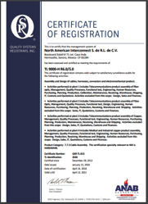
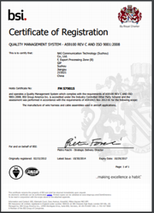
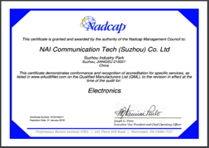
NAI & KSM…A New & Stronger Company
Certifications
• ISO 9001:2015 – for overall quality
• ISO 13485:2016 – for medical product quality
• TL 9000-H R6.2/5.7 – for telecom
product quality
• AS 9100 Rev D– for aerospace product quality
• ITAR registered
• 2021 C-TPAT
• 2021 AEO
• 2020 OEA
• Nadcap Accredited
• UL and (C(UL) Certifications
Let us know what certifications you need!
Reliable Connectivity Solutions
Notes:
Main text slide with subhead; with optional image. Note a title in the header can be set up for the presentation topic, or sub-topics. Please use font sizes shown.

Slide 21
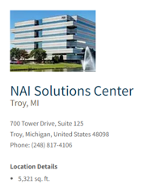
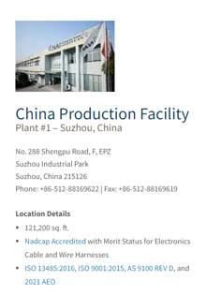
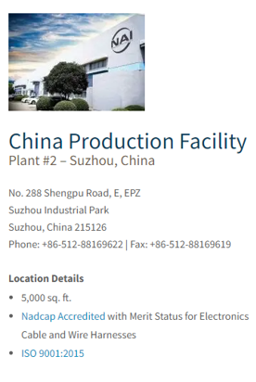
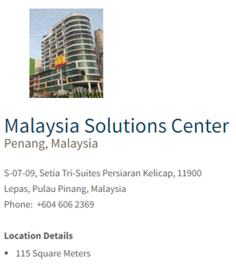
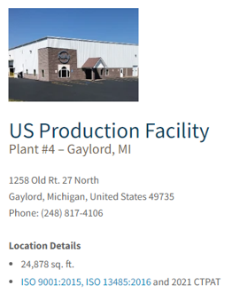
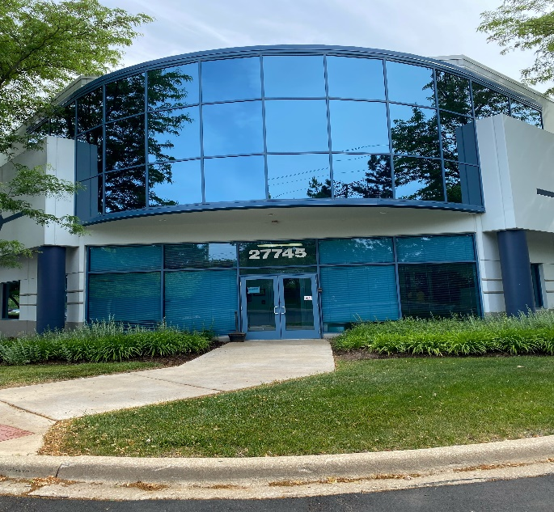
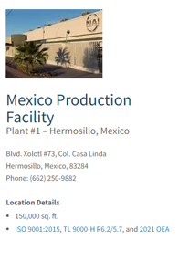
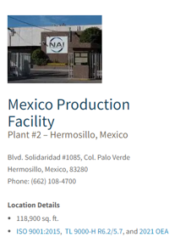
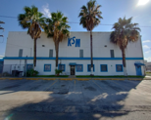
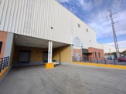
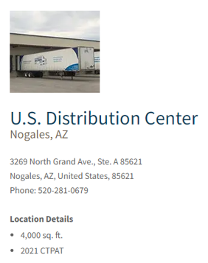
NAI & KSM…A New & Stronger Company
Broad Global Footprint
U.S. Production
Facility - KSM
Plant #5 – Warrenville, IL
27745 Diehl Road
Warrenville, IL 60555
Phone: 800-299-2236
Location Details
- 25,569 sq. ft.
- ISO 9001:2015, AS9100
Mexico Production
Facility - KSM
Plant #3 – Matamoros
Diagonal Lorenzo De La Garza #59
Calle Norte 4 y General Pedro
Hinojosa
Ciudad Industrial
Heroica Matamoros, Tamps,
Mexico C.P. 87494
Location Details
- 21,022 sq. ft.
- ISO 9001: 2015
Mexico Production Facility - KSM
Plant #6 – Guadalajara
Prolongacion Lopez Mateos 18000
Privada De Las Flores 3 Y 5
Santa Cruz de Las Flores
Tlajomulco de Zuniga
Jalisco, Mexico 45640
Location Details
- 21,990 sq. ft.
- ISO 9001: 2015
Reliable Connectivity Solutions
Notes:
Main text slide with subhead; with optional image. Note a title in the header can be set up for the presentation topic, or sub-topics. Please use font sizes shown.

Slide 22
NAI & KSM…A New & Stronger Company
Why this Acquisition?
Benefits for NAI & KSM Customers:
Larger geographical footprint
Access to wholesale distribution for cable and electronic components
Global sourcing for cost containment and reduction
Common commitment to quality and a continuous improvement culture
Expanded sales team with inside service and applications support
Additional finished goods inventory and Vendor Managed Inventory (VMI) option
Broadens experience base in market segments
Reliable Connectivity Solutions
Notes:
Main text slide with subhead; with optional image. Note a title in the header can be set up for the presentation topic, or sub-topics. Please use font sizes shown.

Slide 23
Thank You!
www.nai-group.com
www.ksmelectronics.com
Notes:
Final closing slide.

