Slide 1
Notes:
Main title slide.

Slide 2
RELIABLE CUSTOM
INTERCONNECT SOLUTIONS
Engineered Connectivity for High Performance Systems
XXX
XXXX XXXXX XXXX XXXX
Notes:
For secondary title, if needed (optional).

Slide 3
THE NAI STORY
NAI Connectivity Solutions - Overview
Agile designer and manufacturer of custom cable,
harness and electro-mechanical assemblies
• Custom Engineering & Manufacturing
• Flexible, Nimble and Quick
• Centers of Excellence (CoEs) for New Assembly Designs
• Global Sourcing
• Products for Critical Applications
• Relentless Quality Systems
• An Organization Focused on Learning
• Strong Financial Backing
Reliable Connectivity Solutions
Notes:
Main text slide with subhead. Please use font sizes shown.

Slide 4
THE NAI STORY
Portrait of NAI
• 7 plants with 600,000 sq. ft. production capacity
• Over 2.5 million assemblies/month
• Over 25 million terminations/month
• Over 3,200 personnel and growing
• Flexible and nimble; ramp up quickly for new projects
- Training additions to the labor force
- Capital investments required
- Global procurement
• Dedicated cells for High Mix / Low Volume
• Dedicated cells for High Volume / Low Mix
• Global operations for value & proximity
Reliable Connectivity Solutions
Notes:
Main text slide with subhead. Please use font sizes shown.

Slide 5
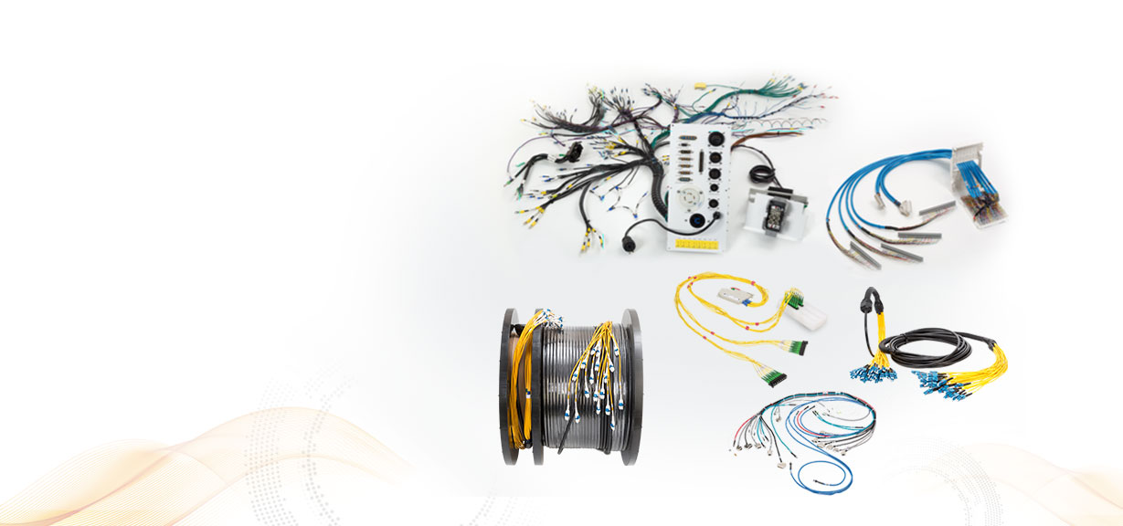
THE NAI STORY
Custom Engineering & Manufacturing
• Cable Assemblies
• Harness Assemblies
• Pre-terminated Assemblies
• Hybrid Assemblies
• Electro-Mechanical Assemblies
- Small to Complex
- Low Mix / High Volume
- High Mix / Low Volume
Reliable Connectivity Solutions
Notes:
Main text slide with subhead. Please use font sizes shown.

Slide 6
THE NAI STORY
Custom Engineering & Manufacturing
Save by outsourcing through NAI
• Two start-up options
• Added value with design engineering services
• Cost savings with alternate components
• Diligent QMS for product reliability
• Quick turnaround on samples and new products
• Fast Prototyping
• Design for Manufacturability (DFM)
Reliable Connectivity Solutions
Notes:
Main text slide with subhead. Please use font sizes shown.

Slide 7
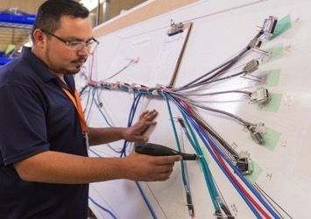
THE NAI STORY
Start-up Options at NAI
NAI’s New Product Introduction (NPI) Process
for new projects with an existing design
• Prepares new projects for production
• Prepare tools & visual aids needed to guide assembly
• Utilize Advanced Product Quality Planning (APQP) process, similar to auto industry
• Create prototype, production sample & BOM
• Dedicated team of engineers & quality experts
• Dedicated facility space
Reliable Connectivity Solutions
Notes:
Main text slide with subhead. Please use font sizes shown.

Slide 8
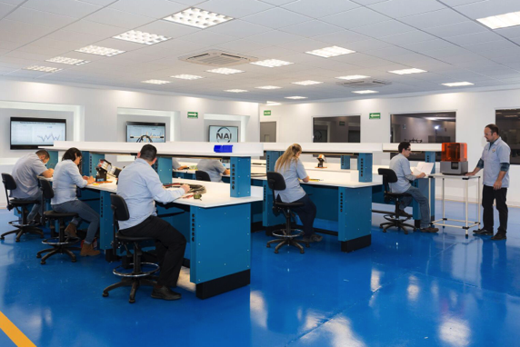
THE NAI STORY
Start-up Options at NAI
2. Centers of Excellence (CoEs) for new projects
requiring design and testing
• CoEs design and develop fiber optic and copper cable
assemblies for customers who need to outsource their design capabilities
• Achieve cost savings for customers by using alternative processes and components to reduce the purchase price variance
• Support the NAI manufacturing process by employing DFM principles in the design process
Reliable Connectivity Solutions
Notes:
Main text slide with subhead. Please use font sizes shown.

Slide 9
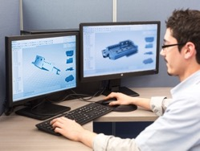
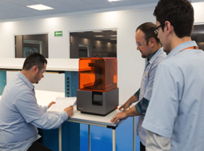
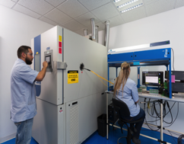
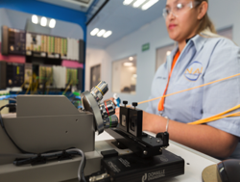
THE NAI STORY
NAI Centers of Excellence (CoEs)
CAD Design & 3D Printing
Testing
Thermal, Immersion, Cross-section, End Face & Geometry
Tensile, Pressure, Texture, IL/IR, Electrical Tests
Reliable Connectivity Solutions
Notes:
Main text slide with subhead. Please use font sizes shown.

Slide 10
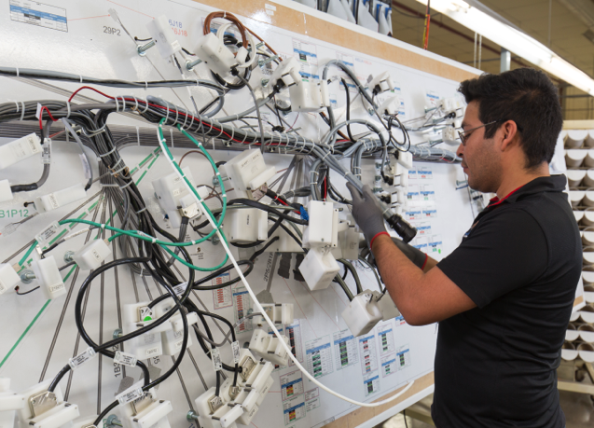
THE NAI STORY
NAI Manufacturing Capability
• Agile management team accelerates decision making for capital expenditures and hiring
• Full production ramp up in less than 4 to 6 weeks
• First article prototypes in less than 2 to 4 weeks, based on component material availability
• Seven plants located worldwide
Reliable Connectivity Solutions
Notes:
Main text slide with subhead. Please use font sizes shown.

Slide 11
THE NAI STORY
Assemblies for Critical Applications
Solutions for Industrial Technologies
• Energy & power
• Measurement & control devices
• Process control
• Testing for pulp & paper manufacturing
• Internet of Things (IoT)
• Network test devices
• Oil & gas testing equipment
• Semiconductor
• Water treatment
Reliable Connectivity Solutions
Notes:
Main text slide with subhead. Please use font sizes shown.

Slide 12
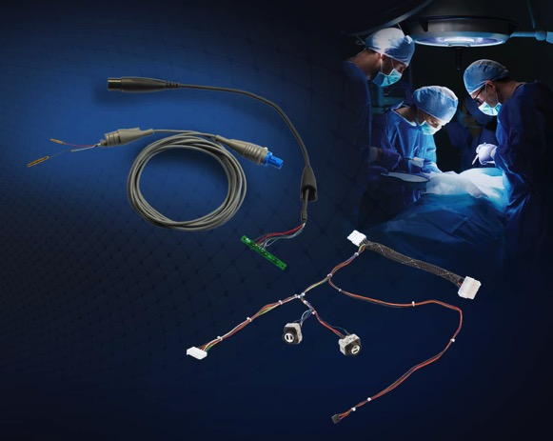
THE NAI STORY
Assemblies for Critical Applications
Medical Devices
• Coblation surgical assemblies
• Overmolded pulse oximeter assemblies
• Surgical knife assemblies
• Ultrasound assemblies
• Laparoscopic surgical assemblies
• Disposable surgical wand assemblies
Reliable Connectivity Solutions
Notes:
Main text slide with subhead. Please use font sizes shown.

Slide 13
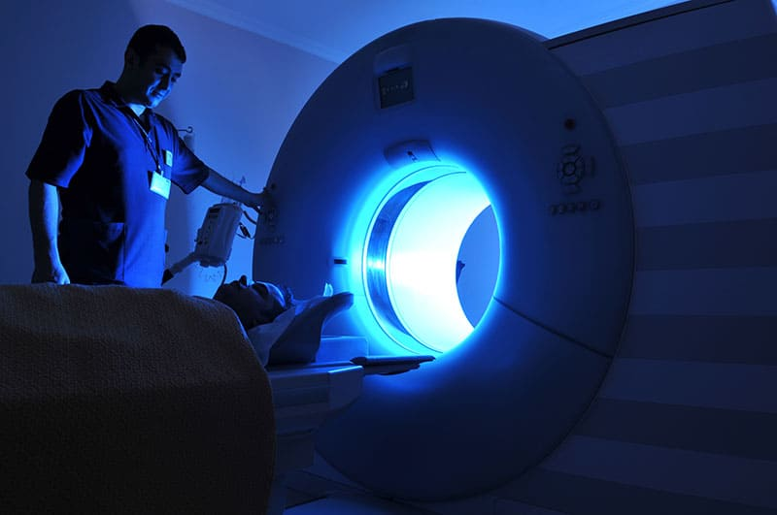
THE NAI STORY
Assemblies for Critical Applications
Medical Equipment
• MRI, PET and CAT Scan equipment
• Autoclave sterilization
• DNA and chemical analysis hardware
• Patient handling equipment
• Other lab and test analysis equipment
Reliable Connectivity Solutions
Notes:
Main text slide with subhead. Please use font sizes shown.

Slide 14
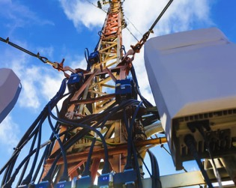
THE NAI STORY
Assemblies for Critical Applications
Telecom & Data
• Upgrading Cell Towers for 4G and 5G LTE
• ADSL/VDSL
• Building Entrance Terminals
• Central Office assemblies
• Full fiber optic jumper cables
• OSP and Central Office protector blocks and panels
Reliable Connectivity Solutions
Notes:
Main text slide with subhead. Please use font sizes shown.

Slide 15
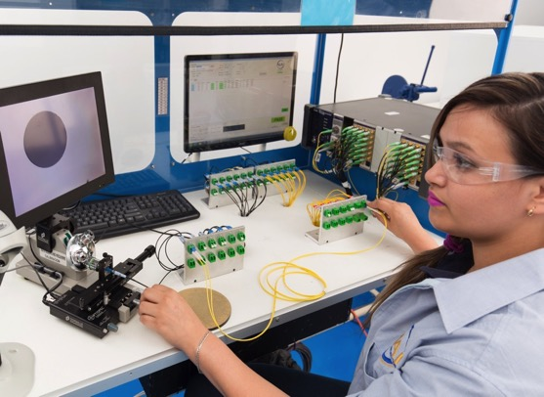
THE NAI STORY
Relentless Quality at NAI
Fiber Optics: Inline Quality Control
All assemblies are 100% inspected. State-of-the-art
equipment used for:
• Insertion Loss / Return Loss
• Attenuation
• Geometry, including concentricity and light continuity
• End face inspection after polishing
• Air cleaning equipment removes contaminants
Reliable Connectivity Solutions
Notes:
Main text slide with subhead. Please use font sizes shown.

Slide 16
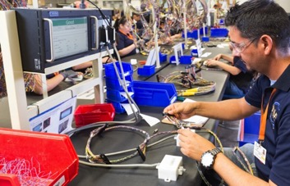
THE NAI STORY
Relentless Quality at NAI
Copper: Inline Quality Control
All assemblies are 100% inspected. Electrical test include continuity, high voltage (HiPot)
and capacity. Some of the tests we perform include:
• Subassy electrical test
• Manufacturing visual inspection
• QA inspection
• Plug blade height
• Tensile test
• Pressure test
• Texture test
• Insertion Loss / Return Loss
Reliable Connectivity Solutions
Notes:
Main text slide with subhead. Please use font sizes shown.

Slide 17
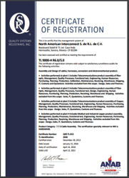
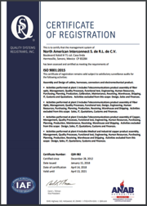
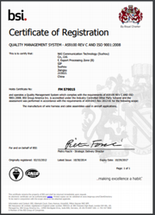
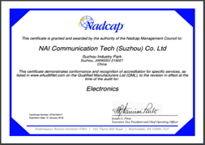
THE NAI STORY
Sterling Quality Systems at NAI
NAI Certifications:
• ISO 9001:2015 – for overall quality
• ISO 13485:2016 – for medical product quality
• TL 9000-H R6.0/5.0 or 5.5 – for telecom product quality
• AS 9100D– for aerospace product quality
• 2011 C-TPAT
• Nadcap Accredited
• UL and (C(UL) certifications
Let us know what certifications you need!
Reliable Connectivity Solutions
Notes:
Main text slide with subhead. Please use font sizes shown.

Slide 18
THE NAI STORY
Sterling Quality Systems at NAI
Sampling of Many Additional Quality Policies & Tools:
• APQP project tracking tools used to monitor progress
• Critical to Quality (CTQ) process adds another layer of testing
• Corrective action taken, when needed
• Equipment calibrations maintained by dedicated crew
• Regular Kaizen events to improve process
• Customers have access to all QC data for their project
Reliable Connectivity Solutions
Notes:
Main text slide with subhead. Please use font sizes shown.

Slide 19
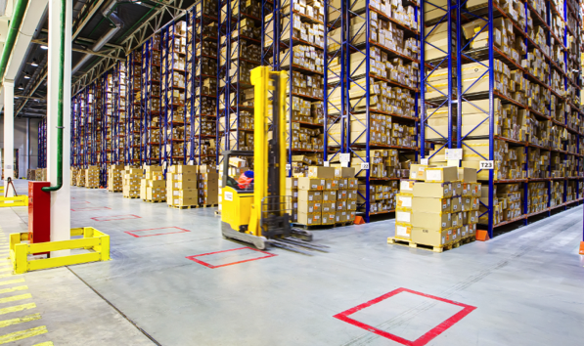
THE NAI STORY
Global Supply Chain & Logistics
• World class integrated Supply Chain Team utilizing
a global MRP system
• Demonstrated experience managing a global supply
base and blended Mexico & China manufacturing
solution for Fortune 500 Companies
• Major focus on reduced cycle time and integrated
component material planning with key suppliers to
ensure on-time delivery (key supplier metrics tracking
and scoring)
• Inventory risk assessment for long LT and custom components
Reliable Connectivity Solutions
Notes:
Main text slide with subhead. Please use font sizes shown.

Slide 20
THE NAI STORY
Global Supply Chain & Logistics
Materials & Components
• Proactive sourcing worldwide
• Huge variety of materials & components
• Alternative material sourcing achieves cost savings
• Internal molding capabilities
Reliable Connectivity Solutions
Notes:
Main text slide with subhead. Please use font sizes shown.

Slide 21
THE NAI STORY
Global Supply Chain & Logistics
Shipping & Logistics
• Regionalized for value & proximity
• Global Distribution Center in Nogales, AZ for
Kanban and vendor managed inventory services
• Global routing alternatives optimize delivery
• Optimize tariff mitigation
Reliable Connectivity Solutions
Notes:
Main text slide with subhead. Please use font sizes shown.

Slide 22
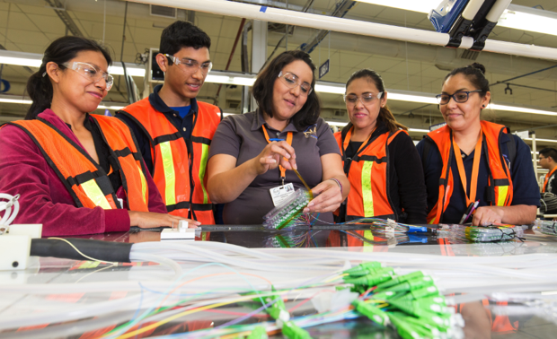
THE NAI STORY
NAI - Focused on Learning
In an Ever-changing Manufacturing Environment
NAI associates are assembly experts with a permanent and dedicated Training Team
• Expert trainers work with new hires
• Specific training programs for each project
• Trainers maintain supervision during production
• Efficiency & quality levels are tracked
• Responsive, fast & competitive
Leadership “U” – formalized education to promote leadership and enhance motivation
Reliable Connectivity Solutions
Notes:
Main text slide with subhead. Please use font sizes shown.

Slide 23
Thank You!
Notes:
Final closing slide.

